Slide 1
What is your pronoun?

Slide 2
Your pronoun is the way in which you refer to yourself, often relating to the way you experience your gender.

Slide 3
Common pronouns:
She
Her
He
Him

Slide 4
But what if gender does not look like this?

Slide 5
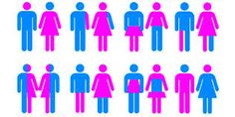
What if gender looks more like this?

Slide 6
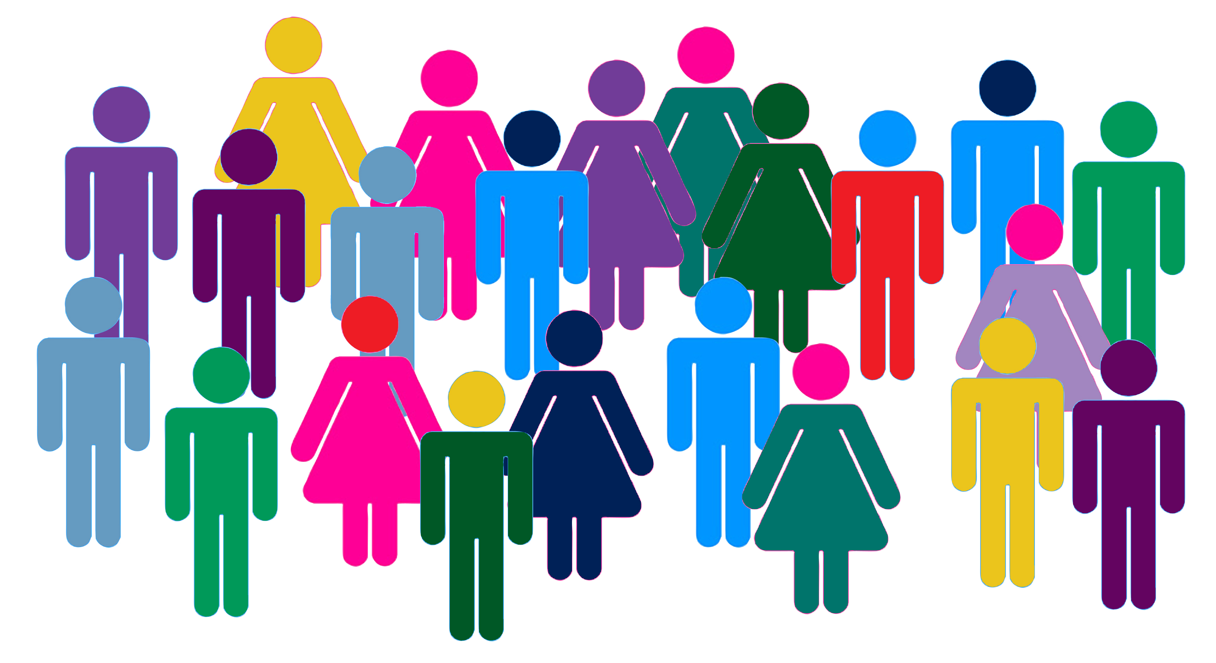
Or this?

Slide 7
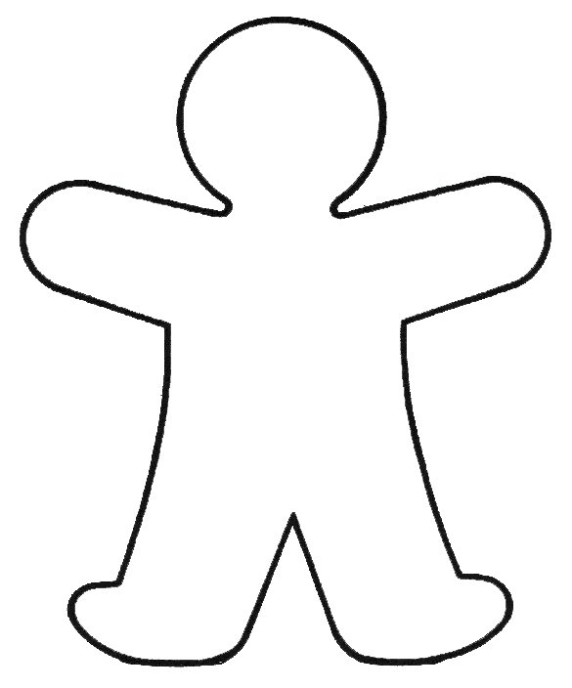
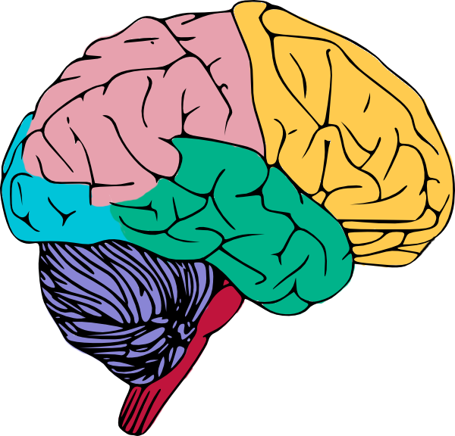
Your gender identity exists within your brain and may or may not “match” with your biological sex:
?

Slide 8
Some words that a person might use to describe their gender identity:
Non Binary Feeling like you are not exclusively “man” or “woman”
Woman
Gender Fluid Feeling like your gender varies over time
Agender Feeling like you have no gender
Man

Slide 9
If you experience gender in a variant way, you may prefer neutral pronouns:
They/them

Slide 10
Guess what?
You have the right to be called by the pronoun you feel most comfortable with!
You should check with people to ask what their pronoun is and not assume!

Slide 11
What is your pronoun?
He?
She?
They?

